Slide 1
Trigonometry – The Sine Ratio
EQ: How do I find missing side lengths using the sine ratio?

Slide 2
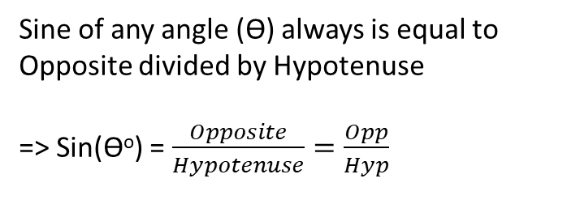
24
7
30
Sine Ratio
EQ: How do I find missing side lengths using Sine Ratio?
Sine Ratio is used when you have the Hypotenuse and Opposite sides on a right angle triangle.
Remember- the hypotenuse is the longest side on the triangle, and is always opposite from the right angle.
Hypotenuse
Opposite
Sine of any angle (ϴ) always is equal to Opposite divided by Hypotenuse
=> Sin(ϴº) = $\frac{Opposite}{Hypotenuse}=\frac{Opp}{Hyp}$
ϴ

Slide 3
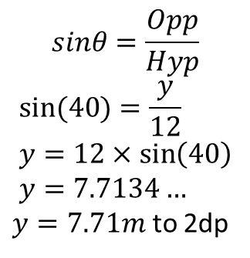
Sin- Variable above the number
EQ: How do I find missing side lengths using Sine Ratio?
1- Label the sides
2- Write the equation as Sin(40) = y/12 – y is the opposite length and 12 is the hypotenuse length.
3- Because the 12 is below the y, we multiply both side by 12 to isolate y.
4- Write the new equation as 12xSin(40) = y
5- Use your calculator to solve 12xsin(40)
6- y = 7.7134…*round to 2 dp* -> 7.71m
12m
Y m
Hypotenuse
Opposite
$$sinθ=\frac{Opp}{Hyp}$$
$$sin⁡(40)=\frac{y}{12} \\ y=12×\sin\left(40\right) \\ y=7.7134…$$ $y=7.71m$ to 2dp
Cross multiply the 12
40º

Slide 4
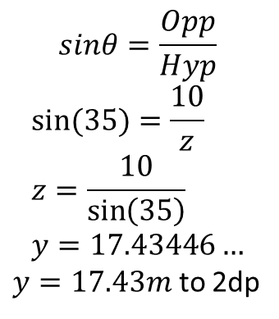
Sin – Variable below the number
EQ: How do I find missing side lengths using Sine Ratio?
1- Label the sides
2- Write the equation as Sin(35) = 10/z – z is the Hypotenuse length and 10 is the opposite length.
3- Because the z is below the 10, we swap the ratio with the variable.
4- Write the new equation as 10/Sin(35) = z
5- Use your calculator to solve 10/sin(35)
6- z = 17.43446…*round to 2 dp* -> 17.43m
Z m
10 m
Hypotenuse
Opposite
$$sinθ=\frac{Opp}{Hyp}$$
$$sin⁡(35)=\frac{10}{z} \\ z=\frac{10}{\sin\left(35\right)} \\ y=17.43446…$$ $y=17.43m$ to 2dp
35º
Cross multiply the sin(35) and the 10
KEY NOTES: if Z is smaller than the number you used, you did something wrong – Z should be the biggest number because it is the hypotenuse.

Slide 5
Key Information:
When the number is below the variable – Multiply both sides by the Variable. [TIMES]
When the number is above the variable – Divide the number by (Ratio x Angle). [SWAP]

Slide 6
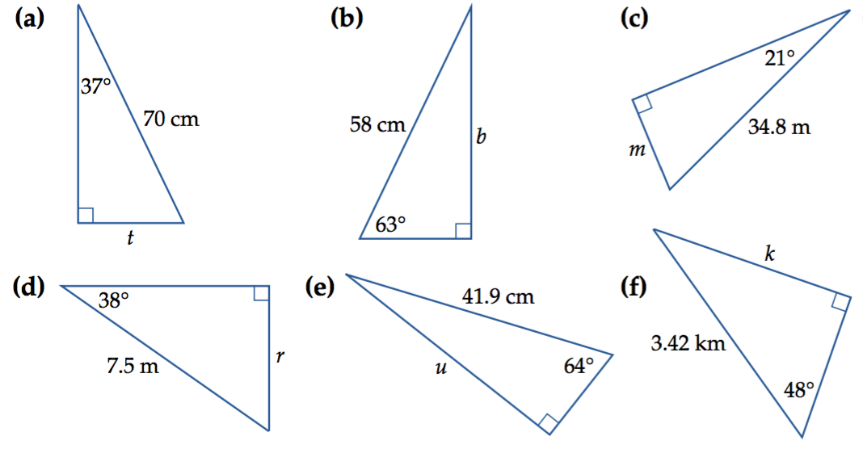
Practise:

Slide 7
ANSWERS
sin(37)= t/ 70,
70xsin(37) = t,
42.13cm = t
sin(63)=b/58
58x sin(63) = b
51.68 = b
c. sin(21) = m/34.8
34.8 x sin(21) = m
12.47 = m
d. sin(38) = r/7.5
7.5 x sin(38) = r
4.62 = r
e. Sin64 = u/41.9
41.9 x sin64 = u
37.66 = u
f. Sin 48 = k/3.42
3.42 x sin 48 = k
2.54 = k

Slide 8
Now complete the worksheet (below) 4a Trig – Cos ratio for finding an angle.
Please draw and label each triangle from the text to your Interactive Notebook.

Slide 9
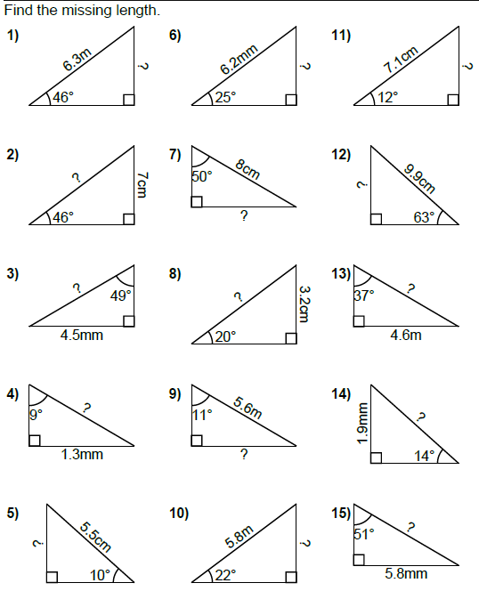

Slide 10
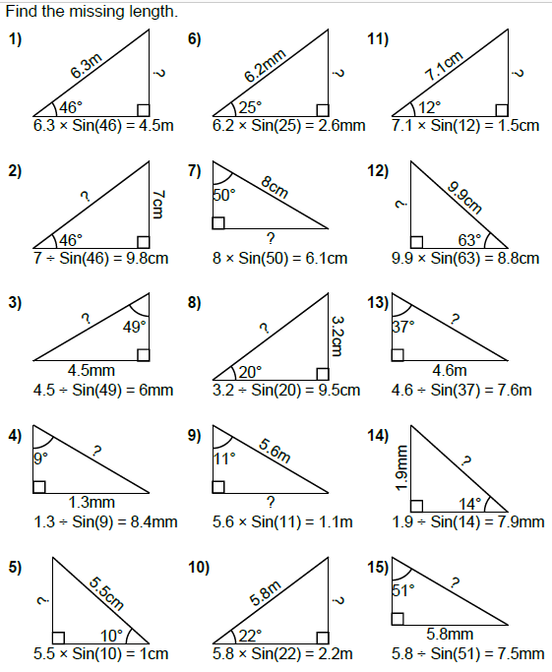
Answers

